Slide 1

SIGMA ACADEMY ci COURSE DAY 1
BY-
MANASA, NIKOLAI & DAVID (SIGMA R&D)

Slide 2
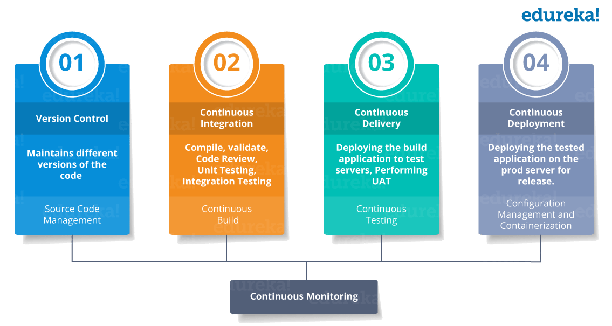
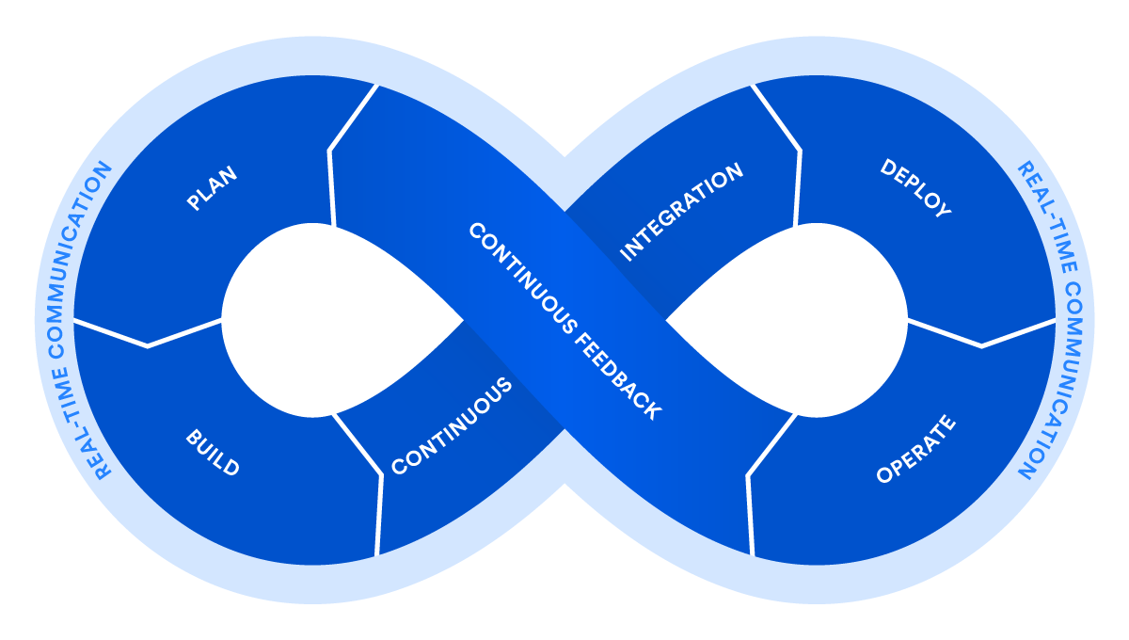
DevOps: LIFECYCLE
Notes:
Devops - Automating the processes between Software development and the IT operations team in order that they can build, test, and release software faster and more reliably
It's a firm handshake between development and operations that emphasizes a shift in mindset, better collaboration, and tighter integration
https://dzone.com/articles/learn-how-to-setup-a-cicd-pipeline-from-scratch

Slide 3

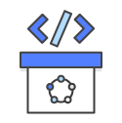


DevOps: PRACTICES
CI / CD
CONTINUOUS DEPLOYMENT
CONTINUOUS DELIVERY
CONTINUOUS INTEGRATION
INFRASTRUCTURE AS CODE
Notes:
Devops - Automating the processes between Software development and the IT operations team in order that they can build, test, and release software faster and more reliably
It's a firm handshake between development and operations that emphasizes a shift in mindset, better collaboration, and tighter integration
The technical goal of CI is to establish a consistent and automated way to build, package, and test applications. With consistency in the integration process in place, teams are more likely to commit code changes more frequently, which leads to better collaboration and software quality.

Slide 4
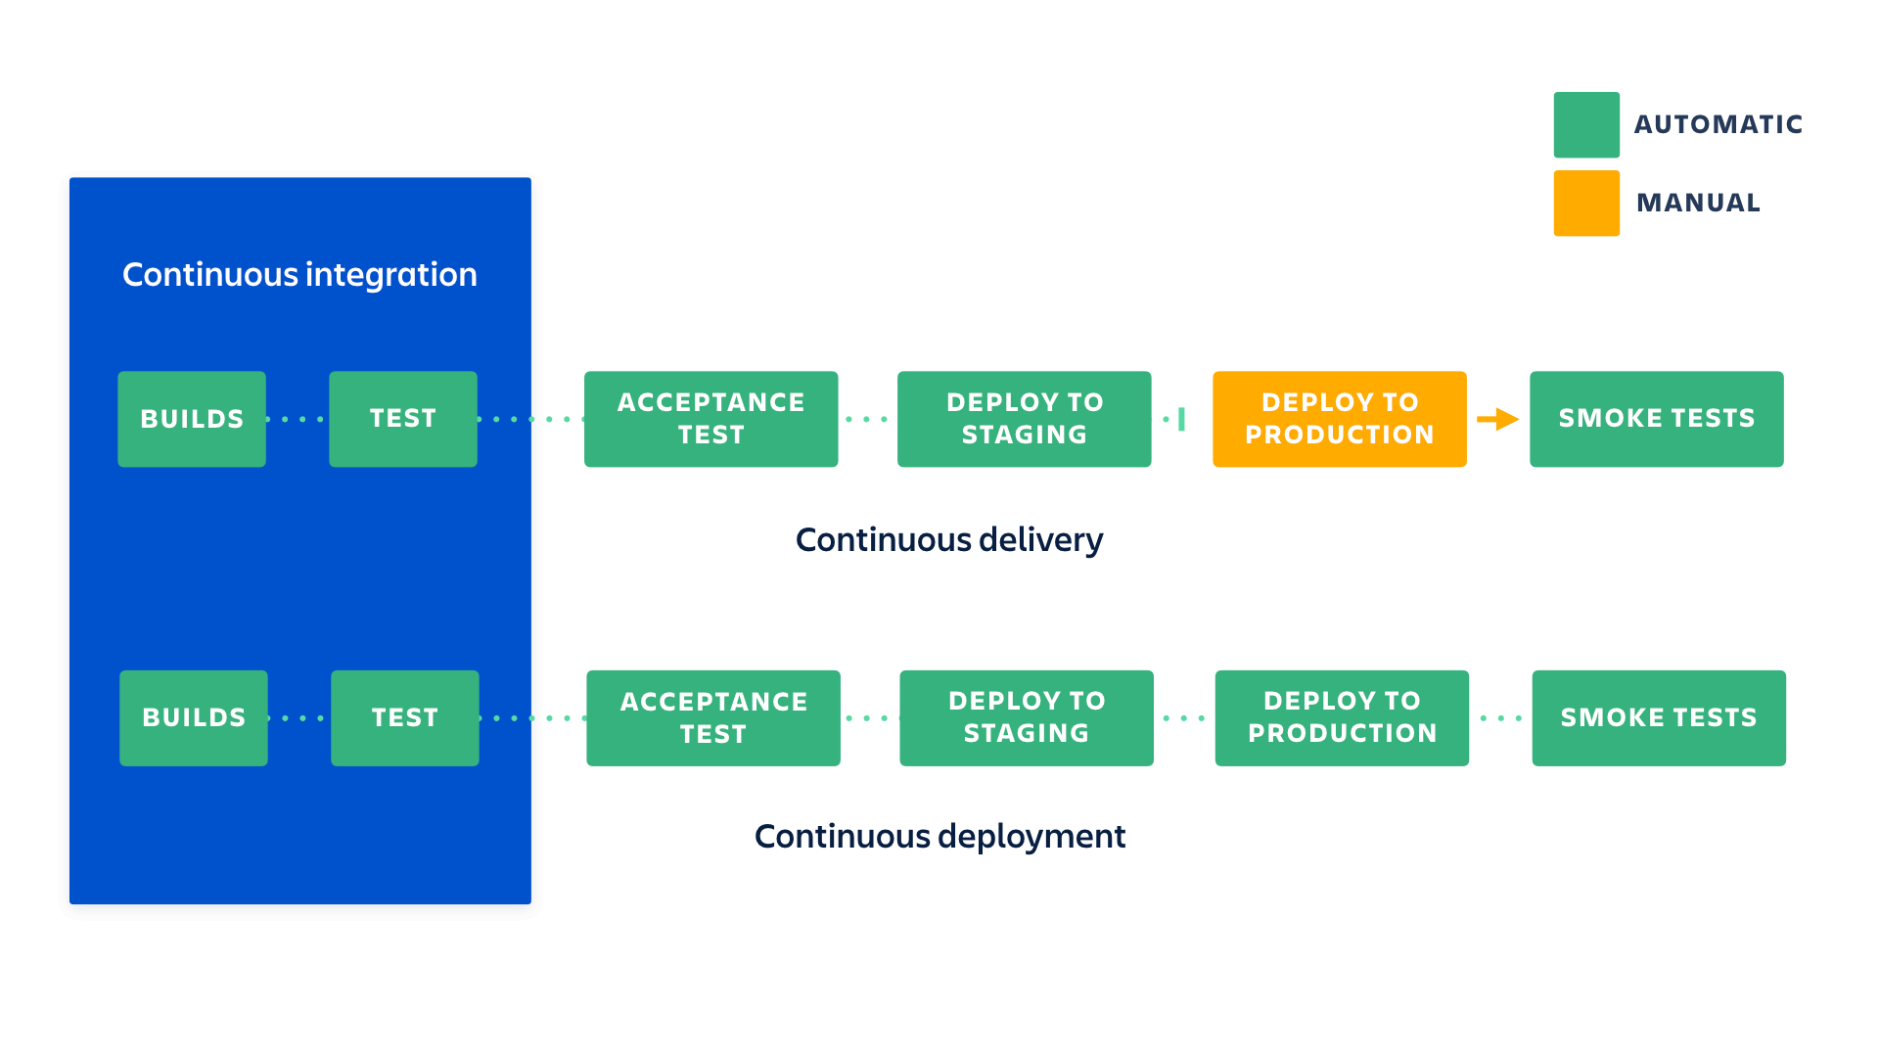
CI/CD : THE WHAT AND THE WHY?
CI/CD is a devops best practice because it addresses the misalignment between developers who want to push changes frequently, with operations that want stable applications.
DevOps practices like continuous integration and continuous delivery solve issues quicker and let organizations deliver rapidly in a safe and reliable manner to their customers.
Notes:
Continuous integration (CI) and continuous delivery (CD) embody a culture, set of operating principles, and collection of practices that enable application development teams to deliver code changes more frequently and reliably. The implementation is also known as the CI/CD pipeline.
Continuous delivery picks up where continuous integration ends. CD automates the delivery of applications to selected infrastructure environments. Most teams work with multiple environments other than the production, such as development and testing environments, and CD ensures there is an automated way to push code changes to them.
CI/CD tools help store the environment-specific parameters that must be packaged with each delivery. CI/CD automation then performs any necessary service calls to web servers, databases, and other services that may need to be restarted or follow other procedures when applications are deployed.
Continuous integration and continuous delivery require continuous testing because the objective is to deliver quality applications and code to users. Continuous testing is often implemented as a set of automated regression, performance, and other tests that are executed in the CI/CD pipeline.
With automation in place, developers can push changes more frequently. Operations teams see greater stability because environments have standard configurations, there is continuous testing in the delivery process, environment variables are separated from the application, and rollback procedures are automated.
Frequent but small updates make each deployment less risky. They help teams address bugs faster because teams can identify the last deployment that caused the error.
The impact of implementing CI/CD pipelines can be measured as a devops key performance indicator (KPI). KPI’s such as deployment frequency, change lead time, and mean time to recovery (MTTR) from an incident are often improved when CI/CD with continuous testing is implemented.

Slide 5
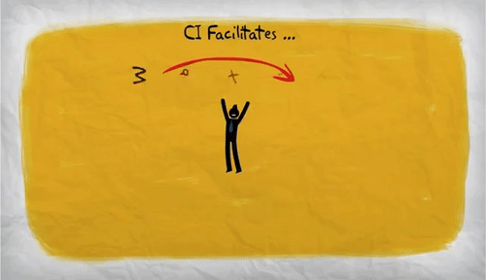
CI : Continuous integration
WHAT? - Continuous integration is a DevOps software development practice where developers regularly merge their code changes into a central repository, after which automated builds and tests are run
WHY? –
Improve Developer Productivity
Better Software Quality
Find and Address Bugs Quicker
Deliver Updates Faster
Notes:
Continuous integration most often refers to the build or integration or test stage of the software release process and entails both an automation component (e.g. a CI or build service) and a cultural component (e.g. learning to integrate frequently)
Continuous Integration (CI) is the process of automating the build and testing of code every time a team member commits changes to version control. CI encourages developers to share their code and unit tests by merging their changes into a shared version control repository after every small task completion. Committing code triggers an automated build system to grab the latest code from the shared repository and to build, test, and validate the full master branch (also known as the trunk or main)
The key goals of continuous integration are to find and address bugs quicker,improve software quality, reduce the time it takes to validate and release new software updates
Developers on a team might work in isolation for an extended period of time and only merge their changes to the master branch once their work was completed.
This made merging code changes difficult and time-consuming, and also resulted in bugs accumulating for a long time without correction.
With continuous integration, developers frequently commit to a shared repository using a version control system such as Git. Prior to each commit, developers may choose to run local unit tests on their code as an extra verification layer before integrating

Slide 6
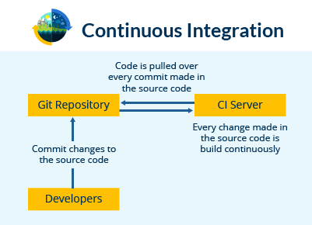

CI : Continuous integration
HOW? - A continuous integration service automatically builds and runs unit tests on the new code changes to immediately surface any errors
Teams use build definitions to ensure that every commit to the master branch triggers the automated build and testing processes
Automated tests run for every build to ensure builds maintain a consistent quality
Notes:
Implementing CI this way ensures bugs are caught earlier in the development cycle, which makes them less expensive to fix
A developer submits a “pull request” when the feature is complete and, on approval of the pull request, the changes get merged into the master branch. Then the developer can delete the previous feature branch
Benefit
more productive by freeing developers from manual tasks and encouraging behaviors that help reduce the number of errors and bugs released to customers.
more frequent testing

Slide 7
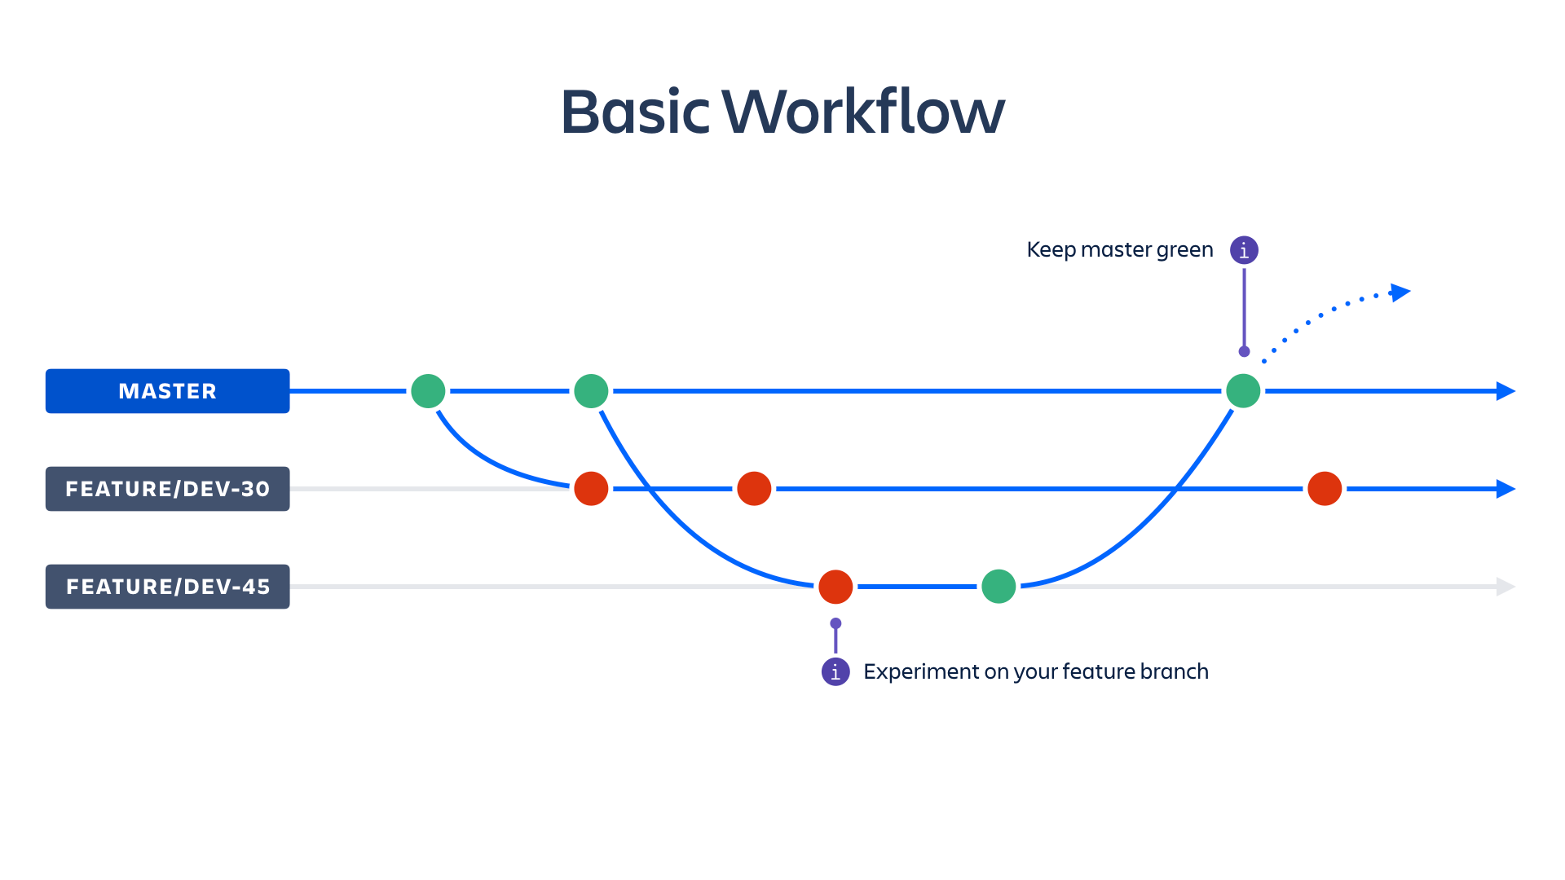
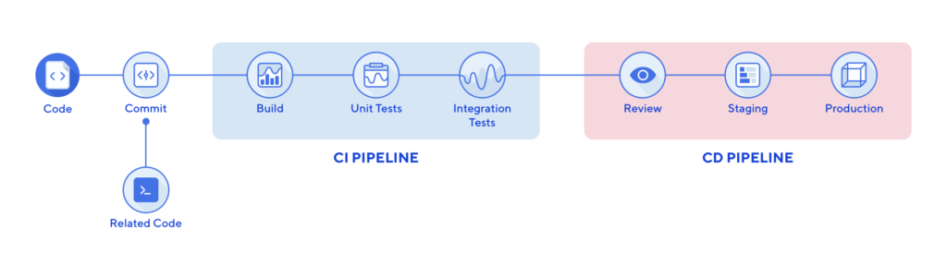
CI : Continuous integration
Notes:
Implementing CI this way ensures bugs are caught earlier in the development cycle, which makes them less expensive to fix
A branching strategy such as Gitflow is selected to define protocols over how new code is merged into standard branches for development, testing and production. Additional feature branches are created for ones that will take longer development cycles. When the feature is complete, the developers can then merge the changes from feature branches into the primary development branch / A developer submits a “pull request” when the feature is complete and, on approval of the pull request, the changes get merged into the master branch. Then the developer can delete the previous feature branch
CI not only packages all the software and database components, but the automation will also execute unit tests and other testing. This testing provides feedback to developers that their code changes didn’t break any existing unit tests.
Benefit
more productive by freeing developers from manual tasks and encouraging behaviors that help reduce the number of errors and bugs released to customers.
more frequent testing
https://www.infoworld.com/article/3271126/what-is-cicd-continuous-integration-and-continuous-delivery-explained.html

Slide 8
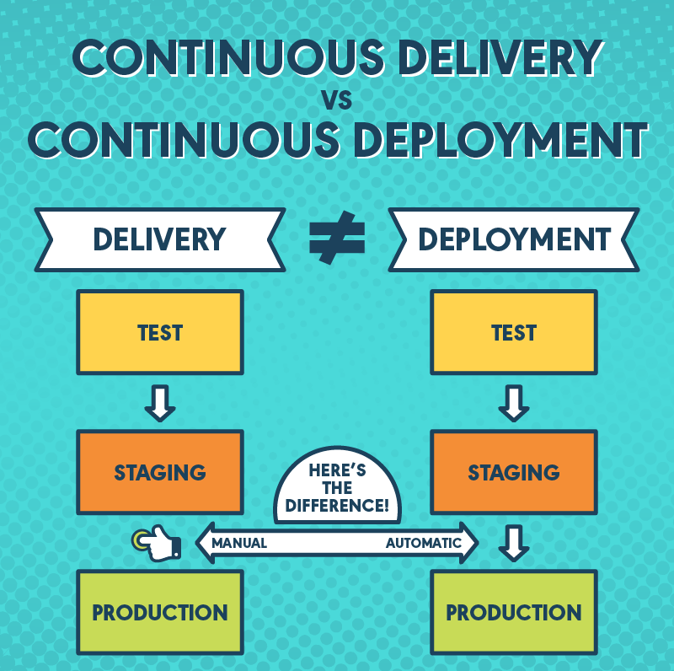
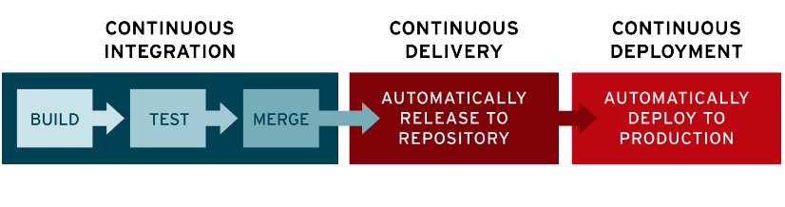
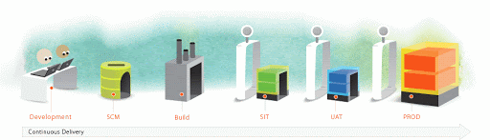
CD : continuous DELIVERY & deployment
Notes:
A mature CI/CD devops practice has the option of implementing continuous deployment where application changes run through the CI/CD pipeline and passing builds are deployed directly to production environments.
Teams practicing continuous delivery elect to deploy to production on a daily or even hourly schedule, though continuous delivery isn’t always optimal for every business application.
They include functionality tests that are developed at the end of every sprint and aggregated into a regression test for the entire application. These regression tests then inform the team whether a code change failed one or more of the tests developed across all functional areas of the application where there is test coverage.
Regression tests are just the start. Performance testing, API testing, static code analysis, security testing, and other testing forms can also be automated. The key is to be able to trigger these tests either through command line, webhook, or web service and that they respond with success or fail status codes.
https://www.youtube.com/watch?v=Rq5TQlPyr8g&feature=emb_logo
https://www.atlassian.com/continuous-delivery/principles/continuous-integration-vs-delivery-vs-deployment

Slide 9
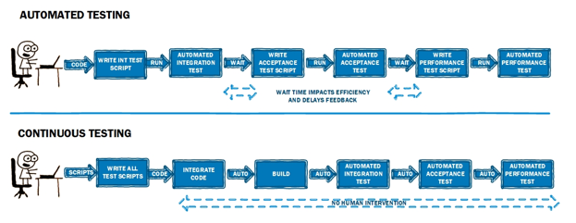
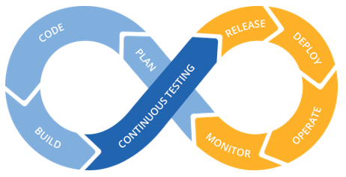
CI/cd: continuous testing
Notes:
https://www.qualitestgroup.com/white-papers/devops-need-continuous-testing/
Continuous Testing is the process of executing automated tests as part of the software delivery pipeline to obtain immediate feedback on the business risks associated with a software release candidate.
Automated testing frameworks help quality assurance engineers define, execute, and automate various types of tests that can help development teams know whether a software build passes or fails. They include functionality tests that are developed at the end of every sprint and aggregated into a regression test for the entire application. These regression tests then inform the team whether a code change failed one or more of the tests developed across all functional areas of the application where there is test coverage.
Regression tests are just the start. Performance testing, API testing, static code analysis, security testing, and other testing forms can also be automated. The key is to be able to trigger these tests either through command line, webhook, or web service and that they respond with success or fail status codes.
Once testing is automated, continuous testing implies that the automation is integrated into the CI/CD pipeline. Some unit and functionality tests can be integrated into CI that flags issues before or during the integration process. Tests that require a full delivery environment such as performance and security testing are often integrated into CD and performed after builds are delivered to target environments.
Continuous Testing doesn’t just manage risk by focusing on test efficiency, it also the effectiveness of our testing processes. If I test nothing, I can do so very efficiently (very fast!), but not very effectively (no coverage!).
Continuous Testing assesses business risk as its primary goal and establishes a safety net that helps the team protect the user experience. Continuous Testing also requires a stable test environment to be available on demand while integrating seamlessly into the software delivery pipeline (where it can deliver actionable feedback at each stage) and DevOps toolchain

Slide 10
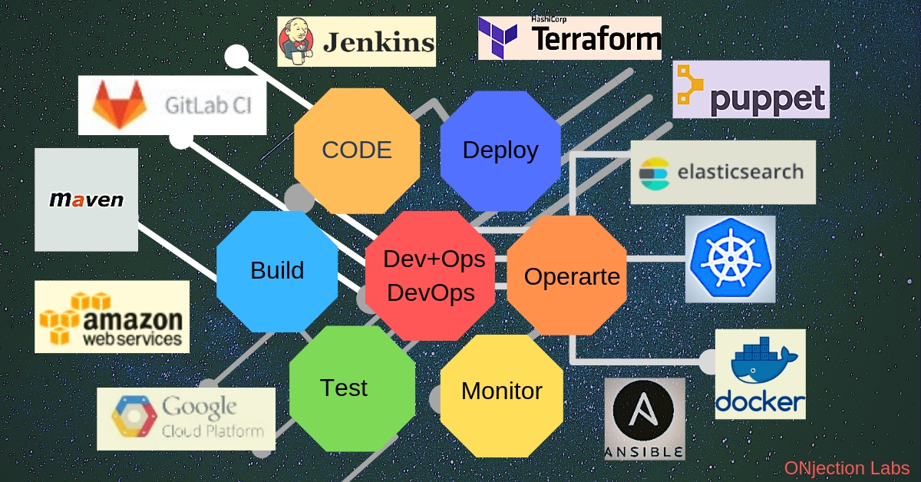
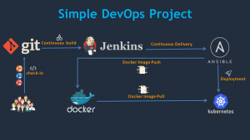
CI/CD : THE VARIOUS TOOLS
Notes:
A CI/CD tool such as Jenkins, CircleCI, AWS CodeBuild, Azure DevOps, Atlassian Bamboo, or Travis CI is used to automate the steps and provide reporting.

Slide 11
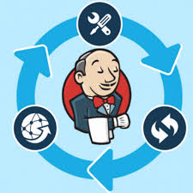
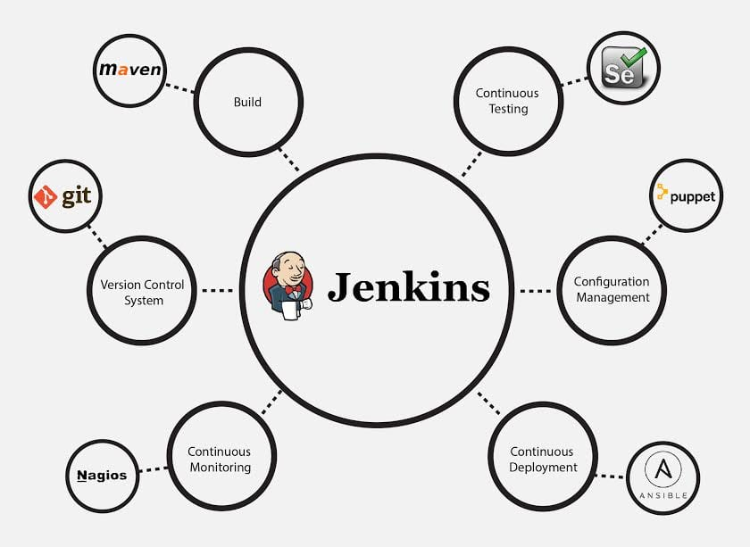
CI/CD : JENKINS
WHAT? - Jenkins is an open source automation tool written in Java with plugins built for Continuous Integration purpose
WHY? –
Adoption: Jenkins is widespread, with more than 147,000 active
Installations
Plugins: Jenkins is interconnected with well over 1,000 plugins
that allows to integrate with most tools.
Notes:
To start, it is helpful to know that Jenkins itself is not a pipeline. Just creating a new Jenkins job does not construct a pipeline. Think about Jenkins like a remote control—it's the place you click a button. What happens when you do click a button depends on what the remote is built to control. Jenkins offers a way for other application APIs, software libraries, build tools, etc. to plug into Jenkins, and it executes and automates the tasks. On its own, Jenkins does not perform any functionality but gets more and more powerful as other tools are plugged into it.
of the development,testing and deployment tools
It also allows you to continuously deliver your software by integrating with a large number of testing and deployment technologies
It is an open source tool with great community support.
It is easy to install.
It has 1000+ plugins to ease your work. If a plugin does not exist, you can code it and share with the community.
It is free of cost.

Slide 12
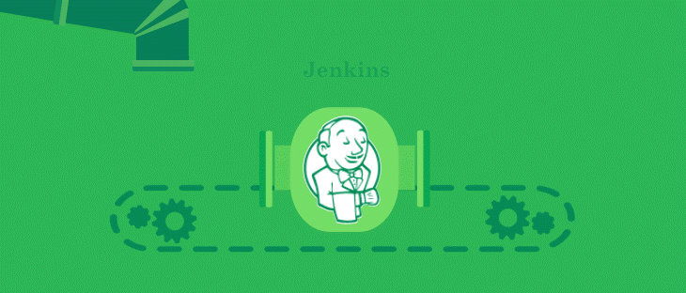
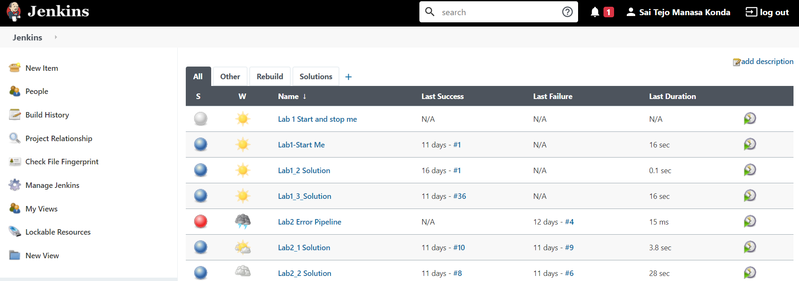
JENKINS
Notes:
https://www.edureka.co/blog/jenkins-tutorial/
Workspace – working directory where code, builds, and other temporary files are stored during a build(jenkins_ci)
Build Trigger – criteria or condition for triggering a build(time, code change, etc)
Build step – task executed during the build process(shell scripts)
Post-build step – additional task executed at the end of the build(send email, archive artifacts, etc)
Artifact – immutable file generated at the end of the build(jar, zip file, cxa, etc)

Slide 13
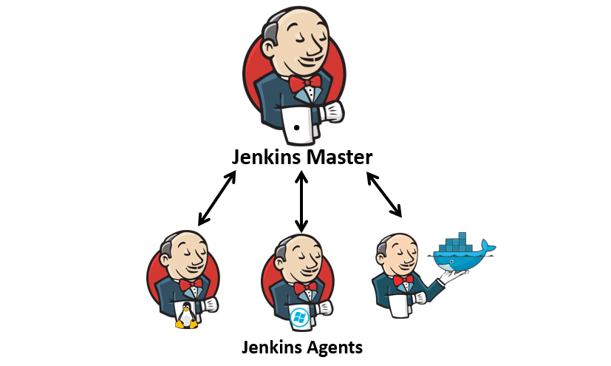
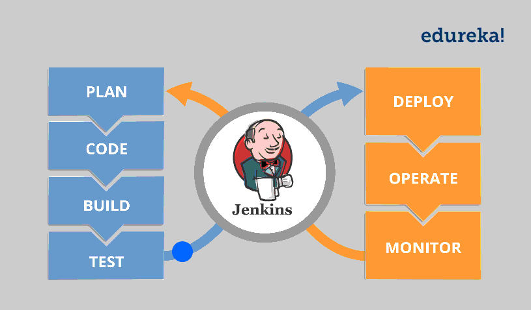
JENKINS
Hears requests from the Jenkins Master
Can be run on variety of OS
Execute build jobs dispatched by Master
Can configure to run on one particular slave or let the Master decide
/ Nodes
Main Jenkins Server
Schedules build jobs and dispatches to slaves
Monitors the slaves
Records and presents the build results

Slide 14



JENKINS demo
Notes:
Jenkins demo

Slide 15
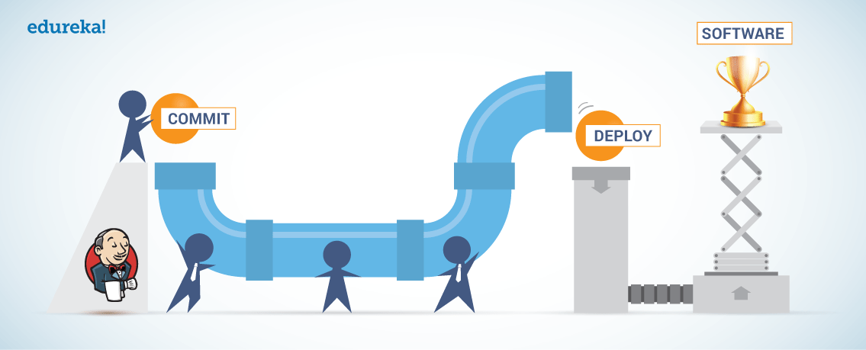
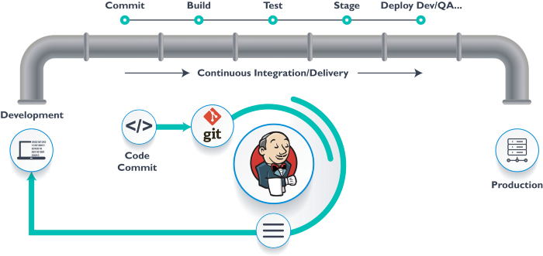
CI/CD PIPELINES
Notes:
CI-CD Pipeline implementation of the Continuous Integration/Continuous Deployment software is the backbone of the modern DevOps environment.
A CI/CD pipeline automates your software delivery process. The pipeline builds code, runs tests (CI), and safely deploys a new version of the application (CD).
Every change to your software (committed in source control) goes through a complex process on its way to being released
This process involves building the software in a reliable and repeatable manner, as well as progressing the built software (called a "build") through multiple stages of testing and deployment
Source stage
In most cases, a pipeline run is triggered by a source code repository. A change in code triggers a notification to the CI/CD tool, which runs the corresponding pipeline. Other common triggers include automatically scheduled or user-initiated workflows, as well as results of other pipelines.
Build stage
We combine the source code and its dependencies to build a runnable instance of our product that we can potentially ship to our end users.
Test stage
In this phase, we run automated tests to validate our code’s correctness and the behavior of our product. The test stage acts as a safety net that prevents easily reproducible bugs from reaching the end-users.
Deploy stages
Once we have a built a runnable instance of our code that has passed all predefined tests, we’re ready to deploy it. There are usually multiple deploy environments, for example, a “beta” or “staging” environment which is used internally by the product team, and a “production” environment for end-users.
https://medium.com/avmconsulting-blog/automated-ci-cd-with-jenkins-39b21c7c8035
https://semaphoreci.com/blog/cicd-pipeline#:~:text=What%20is%20a%20CI%2FCD,and%20enable%20fast%20product%20iterations.

Slide 16
CI/CD PIPELINES USING JENKINS
WHAT? - When it comes to continuous integration and delivery, Jenkins uses a feature called Jenkins pipeline
A pipeline is a collection of jobs that brings the software from version control into the hands of the end users by using automation tools
These pipelines are a collection of Jenkins jobs which trigger each other in a specified sequence
Notes:
They represent multiple Jenkins jobs as one whole workflow in the form of a pipeline. there have been multiple Jenkins pipeline releases including, Jenkins Build flow, Jenkins Build Pipeline plugin, Jenkins Workflow
https://www.edureka.co/blog/jenkins-pipeline-tutorial-continuous-delivery#:~:text=Step%201%3A%20Log%20into%20Jenkins,New%20item'%20from%20the%20dashboard.&text=Step%202%3A%20Next%2C%20enter%20a,on%20'ok'%20to%20proceed.&text=Step%203%3A%20Scroll%20down%20to,pipeline%20or%20a%20scripted%20one.

Slide 17
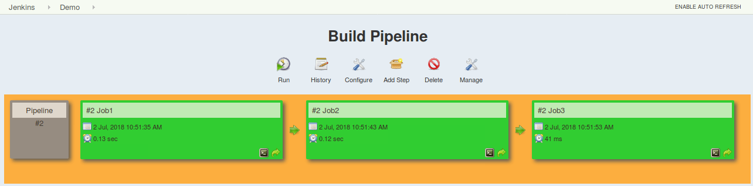
JENKINS PIPELINES
Pipelines are Jenkins jobs enabled by the Pipeline (formerly called “workflow”) plugin and built with simple text scripts that use a Pipeline DSL (domain-specific language) based on the Groovy programming language
Pipelines leverage the power of multiple steps to execute both simple and complex tasks according to parameters that you establish.
Once created, pipelines can build code and orchestrate the work required to drive applications from commit to delivery.

Slide 18
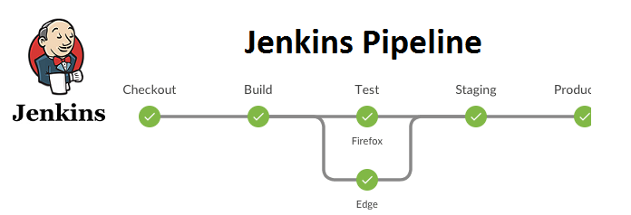
JENKINS PIPELINES
GROOVY DSL
Why use pipelines?
Jenkins pipeline is implemented as a code which allows multiple users to edit and execute the pipeline process
Pipelines are robust. So if your server undergoes an unforeseen restart, the pipeline will be automatically resumed
You can pause the pipeline process and make it wait to resume until there is an input from the user
Jenkins Pipelines support big projects. You can run multiple jobs, and even use pipelines in a loop
Parameters input to Pipeline
Notes:
why use jenkinsfile
Parameters to pipeline…..
Automatically creates a Pipeline build process for all branches and pull requests
Code review/iteration on the Pipeline (along with the remaining source code)
Audit trail for the Pipeline and Single source of truth for the Pipeline, which can be viewed and edited by multiple members of the project

Slide 19
WHAT DID WE LEARN TODAY?
DEVOPS LIFECYCLE AND PRACTICES
INTRO TO CI/CD – WHAT & WHY?
INTRO TO JENKINS - WHAT & WHY?
LIVE JENKINS DEMO
CI/CD PIPELINES USING JENKINS

